Slide 1
Plan S Rights Retention Strategy Slide deck
May 2022
Notes:
Slides can be ‘cherry picked’ and adapted as needed under terms of CC BY licence

Slide 2
Part 1 cOAlition S and Plan S

Slide 3
cOAlition S 27 organizations worldwide
National funders
Austria: FWF
Finland: AKA
France: ANR
Ireland: SFI
Italy: INFN
Luxembourg: FNR
Netherlands: NWO
Norway: RCN
Poland: NCN
Portugal: FCT
Quebec: QRF
Slovenia: ARRS
Sweden: FORMAS, FORTE, VINNOVA
UK: UKRI
European Commission (Horizon Europe)
Charitable foundations
The Wellcome Trust
The Bill & Melinda Gates Foundation
Howard Hughes Medical Institute (HHMI)
Aligning Science Across Parkinson’s (ASAP)
Templeton World Charity Foundation (TWCF)
Global dimension
World Health Organisation + TDR
Jordan: HCST
Zambia : NSTC
South Africa : SAMRC
$40bn in research funds, 150k articles/ year

Slide 4
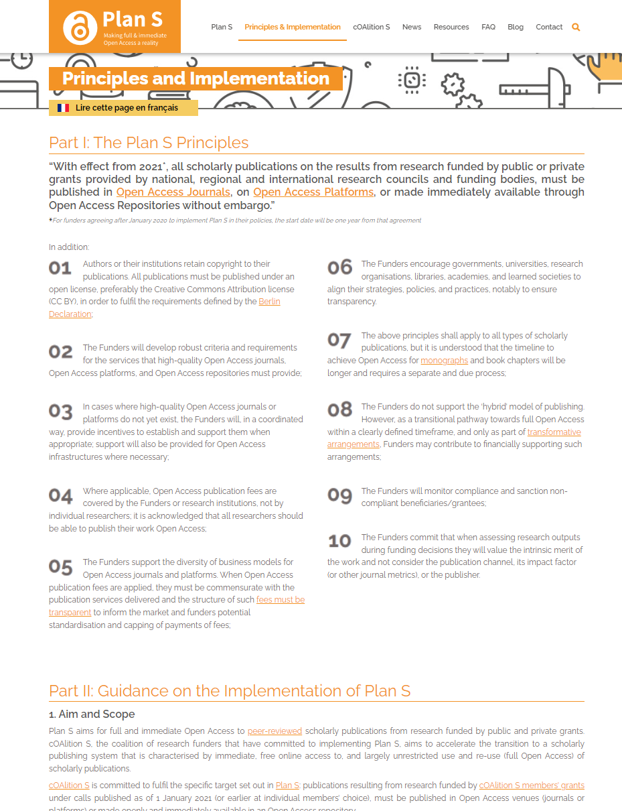
Plan S
Plan S itself is not a policy
Plan S is a set of 10 principles + guidance on implementation
cOAlition S Funders have agreed to implement the 10 principles of Plan S in a coordinated way and align their policies with the principles
https://www.coalition-s.org/addendum-to-the-coalition-s-guidance-on-the-implementation-of-plan-s/principles-and-implementation/

Slide 5
Plan S: strong message
Plan S: ““With effect from 2021*, all scholarly publications on the results from research funded by public or private grants provided by national, regional and international research councils and funding bodies, must be published in Open Access Journals, on Open Access Platforms, or made immediately available through Open Access Repositories without embargo.”
All peer-reviewed papers must be immediate Open Access with a CC-BY license

Slide 6
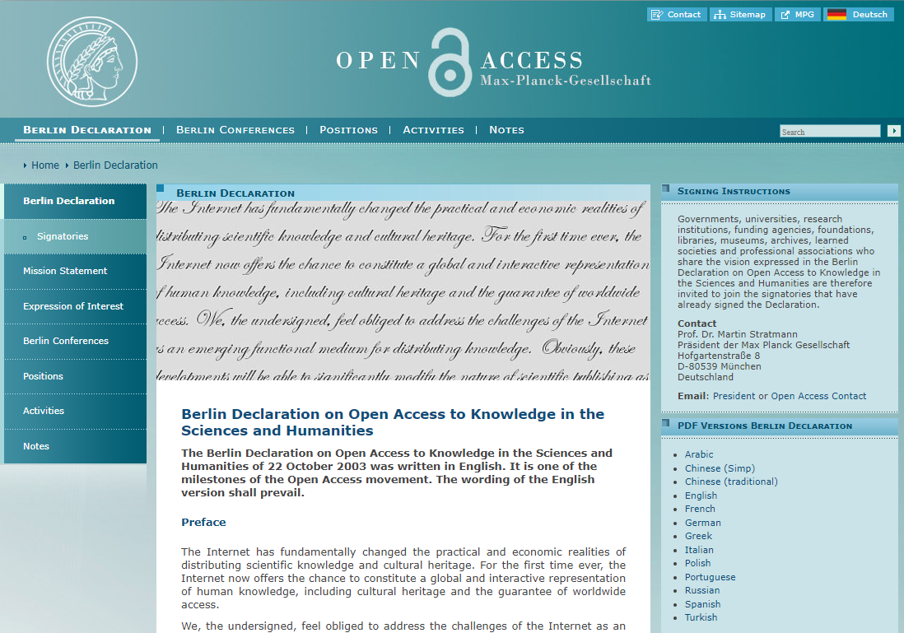
Principle 1 Authors or their institutions retain copyright
Publish under an open license, preferably the Creative Commons Attribution license (CC BY)
“The best way to guarantee we can achieve open access to our research, in all circumstances, is to stop giving away our control over it.”
Simon Bains, University Librarian, University of Aberdeen
https://openaccess.mpg.de/Berlin-Declaration

Slide 7
Part 2 Copyright and licensing

Slide 8
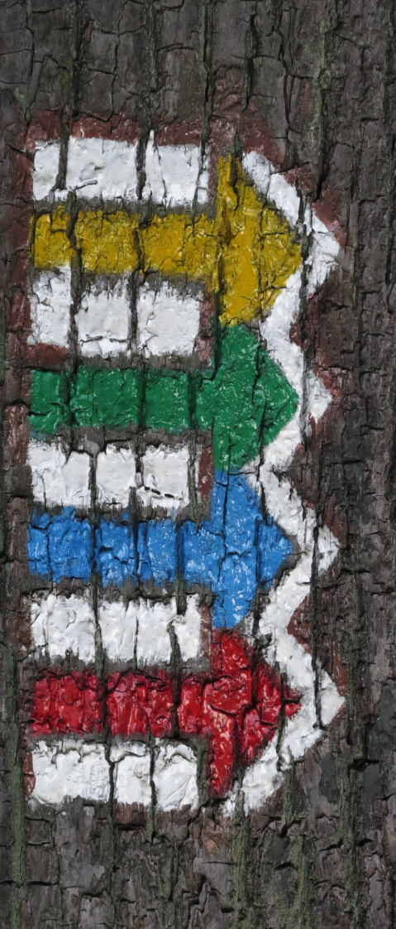
Plan S: three routes to compliance
Route 1
Full Open Access venues
Authors publish in Open Access journal or platform indexed by Directory of Open Access Journals (DOAJ)
cOAlition S funders financially support publication fees for author
Route 2
Subscription journals
Authors publishing in a subscription journal must make the Version of Record or Author Accepted Manuscript instantly available in a repository
*NOT* financially supported by cOAlition S funders
Route 3 Journals under a transformative arrangement
Authors publish in a journal with a Transformative Arrangement.
cOAlition S funders *CAN* financially support Transformative Arrangements
Notes:
There are 3 routes to compliance with Plan S funder’s grant conditions. Here we focus on Route 2, publishing in subscription journals. This includes journals that offer an open access option and that don’t fall under an open access arrangement - your library will help you with this.

Slide 9
Copyright ownership
1. Who owns the original copyright in the content of the researcher’s research article?
2. If the author signs a licence to publish their research article, can the author control the use of the content of their article?
The author does
“Copyright protects your work and stops others from using it without your permission.
Authors get copyright protection automatically: They don’t have to apply or pay a fee.”
It’s up to the author. UK IPO states:
“As a copyright owner, it is for you to decide whether and how to license use of your work.
You can license the use of your work if you own the copyright. You can also decide how your work is used.”
See also UK Copyright Designs & Patent Act 1988, Section 11 https://www.legislation.gov.uk/ukpga/1988/48/section/11
https://www.gov.uk/topic/intellectual-property/copyright
Notes:
The author is granted copyright automatically
And as copyright holder, use of the author’s work is for them to decide. The author can legally decide the terms of any licence they grant
This information about author’s rights is published by the UK Intellectual Property Office or IPO but is common practice in other jurisdictions
[Note: Although author copyright ownership is true for many, some institutions assert copyright over their employees’ outputs]

Slide 10
What happens in practice?
Contributor = author(s)
Owner = Wiley
The publisher presents the author with a Copyright Transfer Agreement (CTA) or Exclusive Licence to Publish (LTP) for signature
Includes permission for the publisher to publish the work - legally required for publication
BUT….Also includes restrictions on how the author is ‘allowed’ to use the work
The author signs the agreement (many do not read)
Result: the publisher has taken control of the rights to the work
CTA
“The Contributor assigns to the Owner, during the full term of copyright and any extensions or renewals, all copyright in and to the Contribution, and all rights therein…”
LTP
“The Contributor grants to the Owner an exclusive license of all rights of copyright in the Contribution during the full term of copyright and any extensions or renewals…”
Notes:
What ACTUALLY usually happens is that the publisher presents the author with a Copyright Transfer Agreement (CTA) or Exclusive Licence to Publish (LTP) for signature
Includes permission for the publisher to publish the work - legally required for publication
BUT….Also includes restrictions on how the author is ‘allowed’ to use the work
The author signs the agreement (some do not read the text)
Result: the publisher has taken control of the rights to the work
Basically, in both cases, the publisher has grabbed all the author’s rights EVEN though, as the IPO states, the author, as copyright holder and licence granter can control how to use their work.
cOAlition S strongly believes that the author is, and should remain, the owner of the intellectual content of the article

Slide 11
Part 3 Plan S Rights Retention Strategy

Slide 12
Rights Retention Strategy (RRS) The principle
The RRS is based on a simple principle: The peer-reviewed Author Accepted manuscript (AAM) is the intellectual creation of the authors and belongs to them.
To assert ownership, the author – as the original copyright holder – applies a CC BY licence to the AAM arising from their submission.
Delivering publication services does not entitle publishers to ownership of the AAM, which remains the intellectual property of the author. Publication services should be paid for, but not with ownership of the AAM.
Funders and universities should ensure that their researchers are not deprived of essential intellectual property rights, a valuable asset.

Slide 13
Rights Retention Strategy (RRS) Objectives
Main objective: All research funded by cOAlition S organisations is OA with zero embargo + CC BY licence
Author ownership and control: Empower researchers working with a cOAlition S funder to retain sufficient intellectual property rights to their Author Accepted Manuscript (AAM).
Global access: Authors who own the rights to their AAM share it in a repository.
Simplicity: Cut through the complexity of journal ‘permissions’: no embargoes. The CC BY licence on the AAM allows authors to share the AAM in a repository, and to freely reuse their own material as they see fit.

Slide 14
Rights Retention Strategy (RRS) The problem we seek to resolve
Minimum requirement for cOAlition S Open Access: A zero-embargo CC BY licensed AAM in a repository
A condition of cOAlition S’ organisations’ grant agreements
Many researchers sign a publishing agreement that gives away their rights to deposit their AAM in a repository, with zero embargo and with CC BY license
This leads to a contradiction between the researchers’ grant agreement and the publishing agreement
The Rights Retention Strategy aims to resolve this contradiction: the CC BY licence takes legal precedence over any conflicting provisions in a later copyright transfer agreement.

Slide 15
Rights Retention Strategy (RRS) Prior licence or prior obligation
cOAlition S organisations’ grant agreements require:
immediate open access for all peer-reviewed publications
sufficient intellectual property rights (IPR) retention to comply with the OA obligations
This is achieved in one of two ways:
Either the grant agreement states that a CC BY licence is applied to all future AAMs financed by the grant (prior licence)
Or the grant agreement requires beneficiaries to apply a CC BY licence to the AAM or the VoR (prior obligation)
In either case, authors should include a statement about the CC BY status of the AAM in their submissions.

Slide 16
Payment for services ≠ claim ownership
I pay decorators to decorate my house:
Strip wallpaper
Sand woodwork
Undercoat and paint window frames
I pay for services:
I do not expect the decorators to own the house after they have painted it
I do not hand over the keys
I do not expect the decorator to grant me permission to live only in the spare room
https://pixabay.com/photos/painter-painting-lackierer-3009887/
https://pixabay.com/photos/house-keys-key-security-door-key-4521073//
https://pixabay.com/photos/money-coins-euro-coins-currency-515058/
Notes:
This analogy illustrates how paying publishers for publishing services should not include permission for them to claim ownership of the intellectual content of the work.

Slide 17
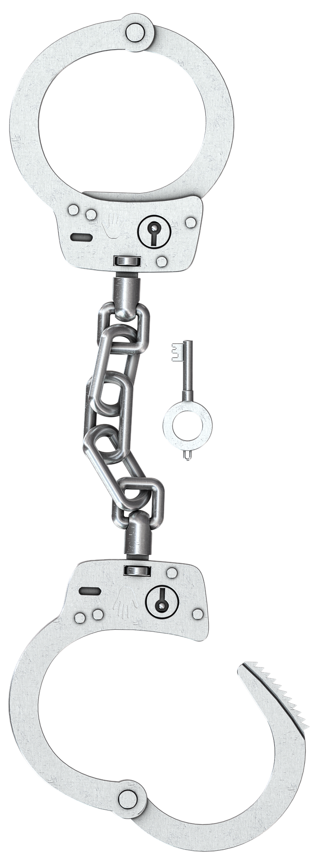
The bottom line: the authors’ hands are tied
Publishers:
have no input into the intellectual content of your work
demand copyright transfer or exclusive licences
are free to make many uses of the work without asking your permission
The author:
Is the creator and original copyright holder of your work
Is severely limited in what they can do with their own work
Including use for the university eg repository
Often has to beg the publisher for permission to reuse parts of their own work
Notes:
Whilst publishers who had no input into the intellectual content of your article, demand copyright transfer or exclusive licences, are free to make many uses of your work without asking your permission, you, as the creator and original copyright holder, are limited to what you can do with your own content - often having to beg permission from the publisher.

Slide 18
Rights Retention Strategy (RRS) AAM v VoR
cOAlition S has 3 equally valid routes to OA: Gold, RRS (Green), and Transformative Arrangements (TAs, TJs, S2O)
Some cOAlition S funders have a preference for an Open Access VoR if prices are fair and reasonable (contributions to Transformative Agreements, Transformative Journals etc).
For these funders, the RRS is a fallback strategy: the AAM will ONLY need to be made Open Access when there is no Plan S-aligned way to make the VoR Open Access.
Other funders and some authors prefer the RRS route.

Slide 19
1
Rights Retention Strategy (RRS) Three steps to implementation
1. Update grant conditions
Grant conditions now specify that authors must apply a public copyright licence (CC BY) to all future Author Accepted Manuscripts (AAMs), and deposit these in a repository.
2. Inform Publishers
Publishers who collectively publish 95% of cOAlition S output have been notified of these changes, with responses incorporated in the Journal Checker Tool.
3. cOAlition S grant holders are asked to:
Include details of the public licence in their submissions
Deposit a copy of the AAM in a repository on publication
2
3

Slide 20
1
Rights Retention Strategy (RRS) What authors need to do
1. To inform the publisher that they are using the RRS, cOAlition S funded researchers should include the following templated language in their submissions:
2. On publication: make AAM open access in a repository
3. Contact their funder (or library) in case of disagreement with or obfuscation by the publisher
2
“This research was funded, in whole or in part, by [Organisation Name, Grant #]. A CC BY licence is applied to the AAM arising from this submission, in accordance with the grant’s open access conditions.”
3

Slide 21
Publishers’ smoke & mirrors What authors may be told
You cannot use the RRS statement when submitting to this journal.
You can and you should. The only option for the journal is to refuse your paper upon submission.
Before proceeding with your submission, you must agree to pay an APC for publication (even if your funder does not)
Beware! This publisher is suggesting that you enter into a contractual agreement. Check if there is an option to discuss the APC before submission.
The publisher asks you to sign a separate contract to respect their embargo (despite their knowledge of your preexisting grant agreement with the funder to publish without an embargo)
Beware! If you sign a contract agreeing to an embargo period, then you will be in breach of your grant conditions.

Slide 22
Publishers’ smoke & mirrors
Some publishers
are knowingly putting authors wishing to use the RRS in a difficult situation
Contracts can contradict the Grant Agreement the University signed with the Funder
delete the RRS language from the article (censorship or copyediting?)
sometimes wait until acceptance to present contract terms
Publishers have the right to desk-reject articles with the RRS language, but not to confuse, mislead or trick authors into violating their grant agreement.
cOAlition S has recently written a letter to 150 publishers asking them to be clear about conditions at submission
Notes:
cOAlition S has this matter under review.

Slide 23
Part 4
The direction of travel

Slide 24
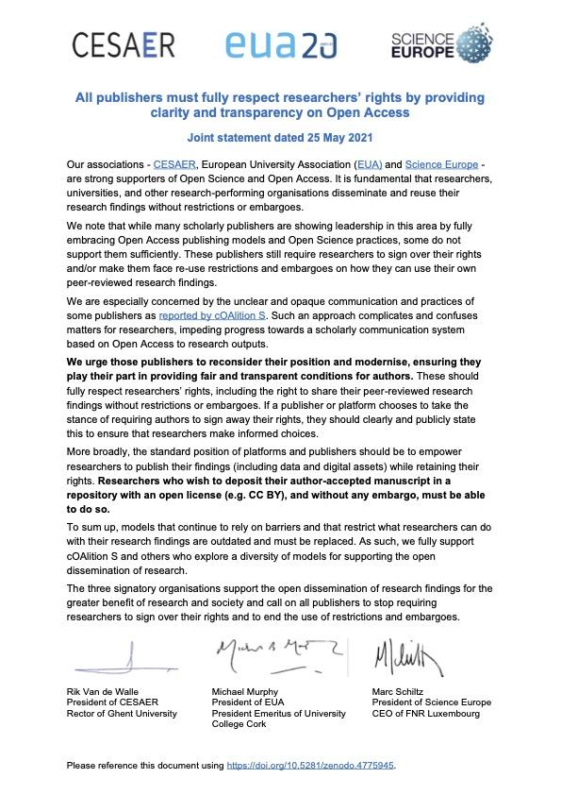
EUA, CESAER, and SE letter to publishers
“We are especially concerned by the unclear and opaque communication and practices of some publishers as reported by cOAlition S.”
"Researchers who wish to deposit their author-accepted manuscript in a repository with an open license (e.g. CC BY), and without any embargo, must be able to do so.”
Notes:
It’s not just cOAlition S funders who are frustrated by some publisher’s efforts to confuse authors.
Here is one example of an open letter from researchers’ organisations requesting those publishers ‘reconsider their position and modernise, ensuring they play their part in providing fair and transparent conditions for authors.’
There are others in the same vein including Eurodoc and Marie Curie Alumni Association

Slide 25
Section II: Definition of Open Science
“Any transfer or licensing of copyrights to third parties should not restrict the public’s right to immediate open access to a scientific publication.”
[Para 7a, Page 9]
Plan S Rights Retention Strategy predates, but fulfils this clause precisely
Adopted Nov 2021
https://en.unesco.org/science-sustainable-future/open-science/recommendation
Notes:
In November 2021 UNESCO published its recommendation on Open Science.
In it it states that
Any transfer or licensing of copyrights to third parties should not restrict the public’s right to immediate open access to a scientific publication
cOAlition S Rights Retention Strategy predates this recommendation, but fulfils this clause precisely

Slide 26
G6 statement on Open Science
Reaching 100% of Open Access is a main goal for all of our institutions but researchers cannot freely share and build on the results they publish if publishers hold copyrights of their articles and monographs. Therefore, we are committed to support our researchers to retain sufficient rights to publish their scholarly articles and monographs openly and we encourage them to publish their results (i.e. final version and/or manuscript) under an open license, preferably the Creative Commons Attribution License CC BY.
Brussels, December 2021
https://os.helmholtz.de/en/open-science-in-the-helmholtz-association/national-international-network/g6-and-open-science/
Notes:
The opinion of the G6 group of institutions concurs with that of cOAlition S
They see a shift to fully open access as a priority, but know that handing over the rights to the content of publications hampers their researchers when sharing their work.
They are therefore committed to support their researchers to retain sufficient rights to publish their scholarly works openly and under an open license
This directly matches the cOAlition S view.

Slide 27
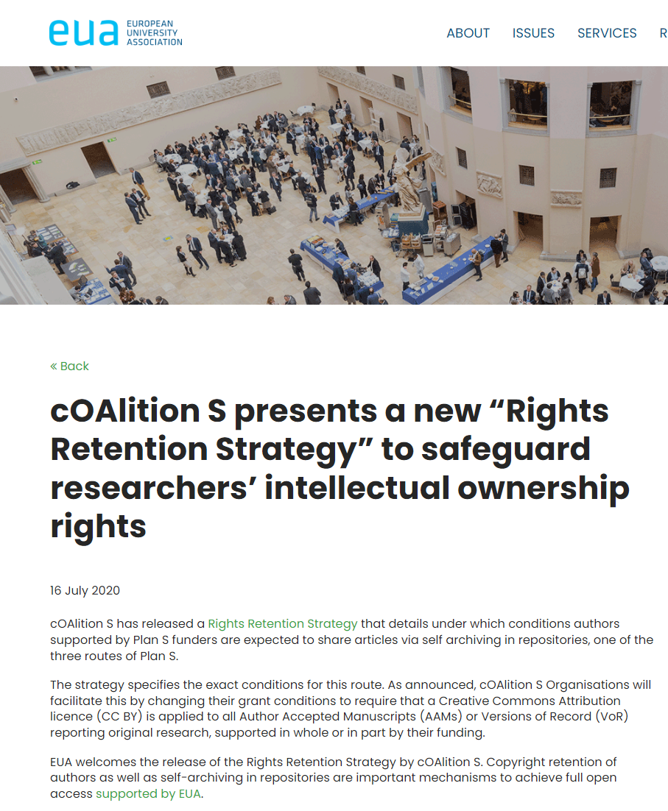
RRS
ENDORSED
Notes:
The European University Association, which comprises over 850 universities and rectors associations across Europe, has publicly endorsed the cOAlition S rights retention strategy

Slide 28
“Reclaiming academic ownership of the scholarly publishing system
Universities, research performing organisations, researchers, research funders and national libraries all have a crucial role to play in re-gaining academic sovereignty over the publishing process. Institutions and researchers have relinquished their rights to commercial publishers, and these publishers have made copyright their mainstay.
Authors and institutions need to retain their intellectual property rights (e.g. Plan S Rights Retention Strategy) and critically consider which stakeholders should own and run publishing infrastructure in order to create systemic change.”
https://eua.eu/downloads/publications/eua%20os%20agenda.pdf
Notes:
In it’s Open Science agenda 2025, EUA clearly stated that
“Authors and institutions need to retain their intellectual property rights (for example using Plan S Rights Retention Strategy) and critically consider which stakeholders should own and run publishing infrastructure in order to create systemic change.”
EUA stated that to make this a reality it will advocate to reclaim academic ownership of scholarly communication and publishing, and support the cOAlition S rights retention strategy
This is the direction of travel which is becoming increasingly evident around the globe.

Slide 29
Council of Europe
“Draft Council text in line with Plan S open-access initiative on intellectual property”
French presidency of the Council of the EU
Draft ministerial position for research ministers to adopt as EU member state governments’ position
Authors of research papers should retain intellectual property over their work
29 April version of the draft Council conclusions states
“the authors of publications or their institutions should retain sufficient intellectual property rights to ensure open access [to those publications], leading to broader dissemination, valorisation and reuse of [research] results”.
In line with cOAlition S funders Rights Retention Strategy.
As reported in Research Professional News 3rd May 2022
https://www.researchprofessionalnews.com/rr-news-europe-infrastructure-2022-5-eu-ministers-could-swing-behind-authors-holding-on-to-their-ip/
Notes:
Under the French presidency the Council of the EU, a ministerial position has been drafted that states that authors of publications or their institutions should retain sufficient intellectual property rights to ensure open access, broader dissemination, valorisation and re-use of research results. This reform of research assessment and open science is in direct alignment with the cOAlition S rights retention strategy.
Authors of research papers should retain intellectual property over their work
The draft text is being developed for research ministers to adopt as EU member state governments’ position on assessment reform and open science.
It will shape an agreement for stakeholders that is being drafted by university and funder groups under the coordination of the European Commission.
EU ministers could swing behind authors holding on to their IP
Draft Council text in line with Plan S open-access initiative on intellectual property
Comment on this article
A draft ministerial position on reforming research assessment and open science has been revised to say that authors of research papers should retain intellectual property over their work—weighing in on what has become a contested issue in academia in recent years.
The draft text, from the French presidency of the Council of the EU, is being developed for research ministers to adopt as EU member state governments’ position on assessment reform and open science. This will shape an agreement for stakeholders that is being drafted by university and funder groups under the coordination of the European Commission.
Dated 29 April, the latest version of the draft Council conclusions has a new section added, which states that “the authors of publications or their institutions should retain sufficient intellectual property rights to ensure open access [to those publications], leading to broader dissemination, valorisation and reuse of [research] results”.
In line with Plan S
This proposal from the French presidency is in line with the policies of the group of funders taking part in the Plan S open-access initiative, who are requiring the researchers they support to retain copyright over their publications or assign it to their employing institutions.
Only last week, Plan S launched a campaign to help authors retain their copyright, and accused some publishers of being “unclear and obstructive” about their policies around author rights retention. Some publishers have insisted on “the author agreeing to an [open-access] embargo by using a contract, or other tactics, that conflicts with their grant condition” on rights, Plan S claimed.
Retaining copyright over their work enables authors to upload it to an open-access repository, which in turn is a way that they can comply with the Plan S requirement that all work supported by the participating funders must be made openly available immediately.
Another revision in the latest draft text invites the Commission to “work on a regulatory framework that enables unimpeded access to and reuse of publicly funded research results, publications and data for research purposes”.
The draft, which is due to be discussed by national representatives this week, was also revised in April to increase its focus on open science. Its main thrust remains that researcher assessment is currently too focused on the use of quantitative journal and publication-based indicators.

Slide 30
Part 5 Academe takes back control

Slide 31
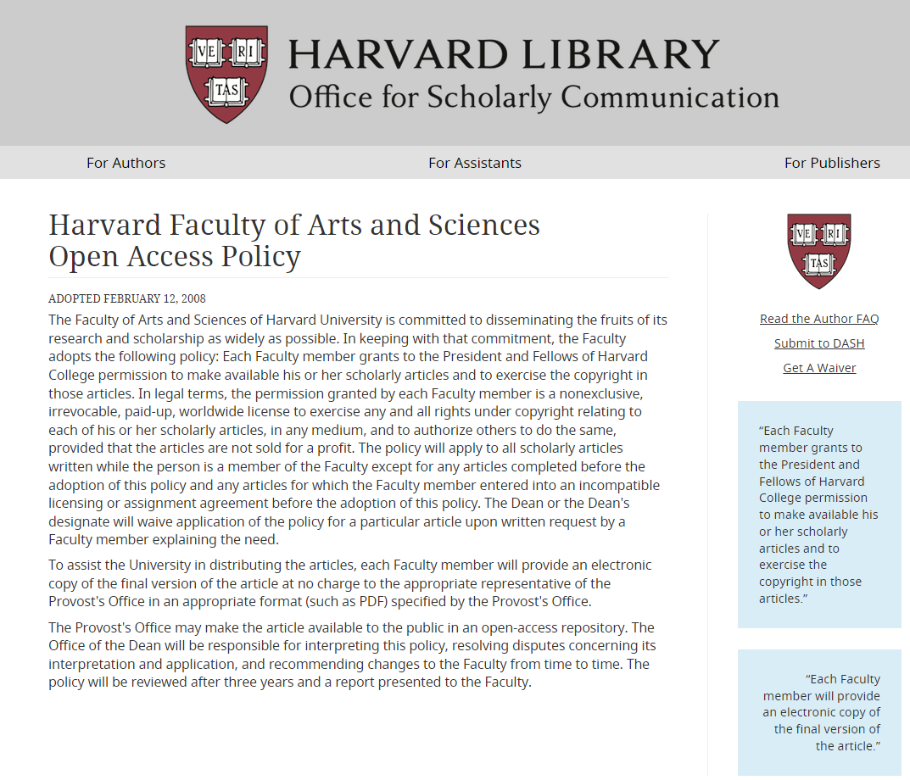
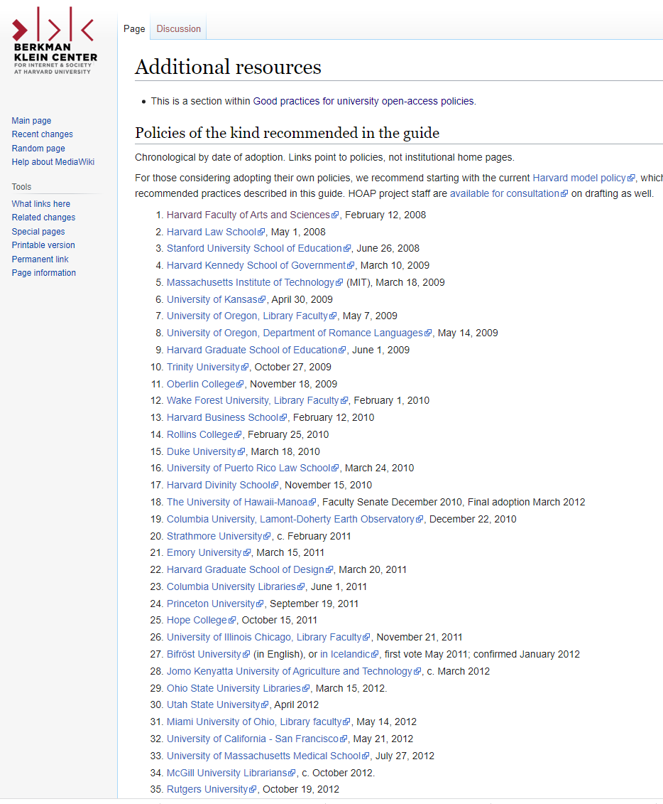
Rights Retention Strategy (RRS) Academe starts to take back control
https://osc.hul.harvard.edu/policies/
https://cyber.harvard.edu/hoap/Additional_resources#Policies_of_the_kind_recommended_in_the_guide
Notes:
“Rights retention specifically acknowledges not just the hard work, but the ownership of the expression of ideas by researchers.” (Paul Rigg, Birkbeck, University of London) This is why it is important for institutions, as well as funders, to help authors to retain their rights.
In 2008, Harvard's Faculty of Arts & Sciences voted unanimously to give Harvard a nonexclusive, irrevocable right to distribute their scholarly articles for any non-commercial purpose – a type of rights retention based policy. What took off at Harvard with its unanimously faculty approved permissions-based policy, is extending across other universities
There is a long list of institutions with similar policies

Slide 32
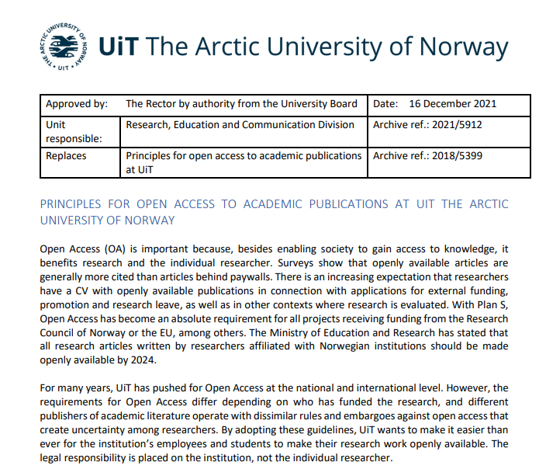
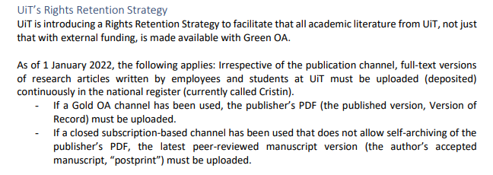
Rights Retention Strategy (RRS) Academe starts to take back control
https://en.uit.no/publishing#innhold_681363
Notes:
The Arctic University of Norway published its policy that came into effect from 1st January 2022.
The policy includes a rights retention aspect
“For employees and students wishing to publish in academic publication channels that have subscription-based access, UiT’s infrastructure for self-archiving (Green OA) shall ensure Open Access to the academic literature”
https://uit.no/Content/762228/cache=1643633369000/PRINCIPLES%20FOR%20OPEN%20ACCESS%20TO%20ACADEMIC%20PUBLICATIONS%20AT%20UIT.pdf

Slide 33
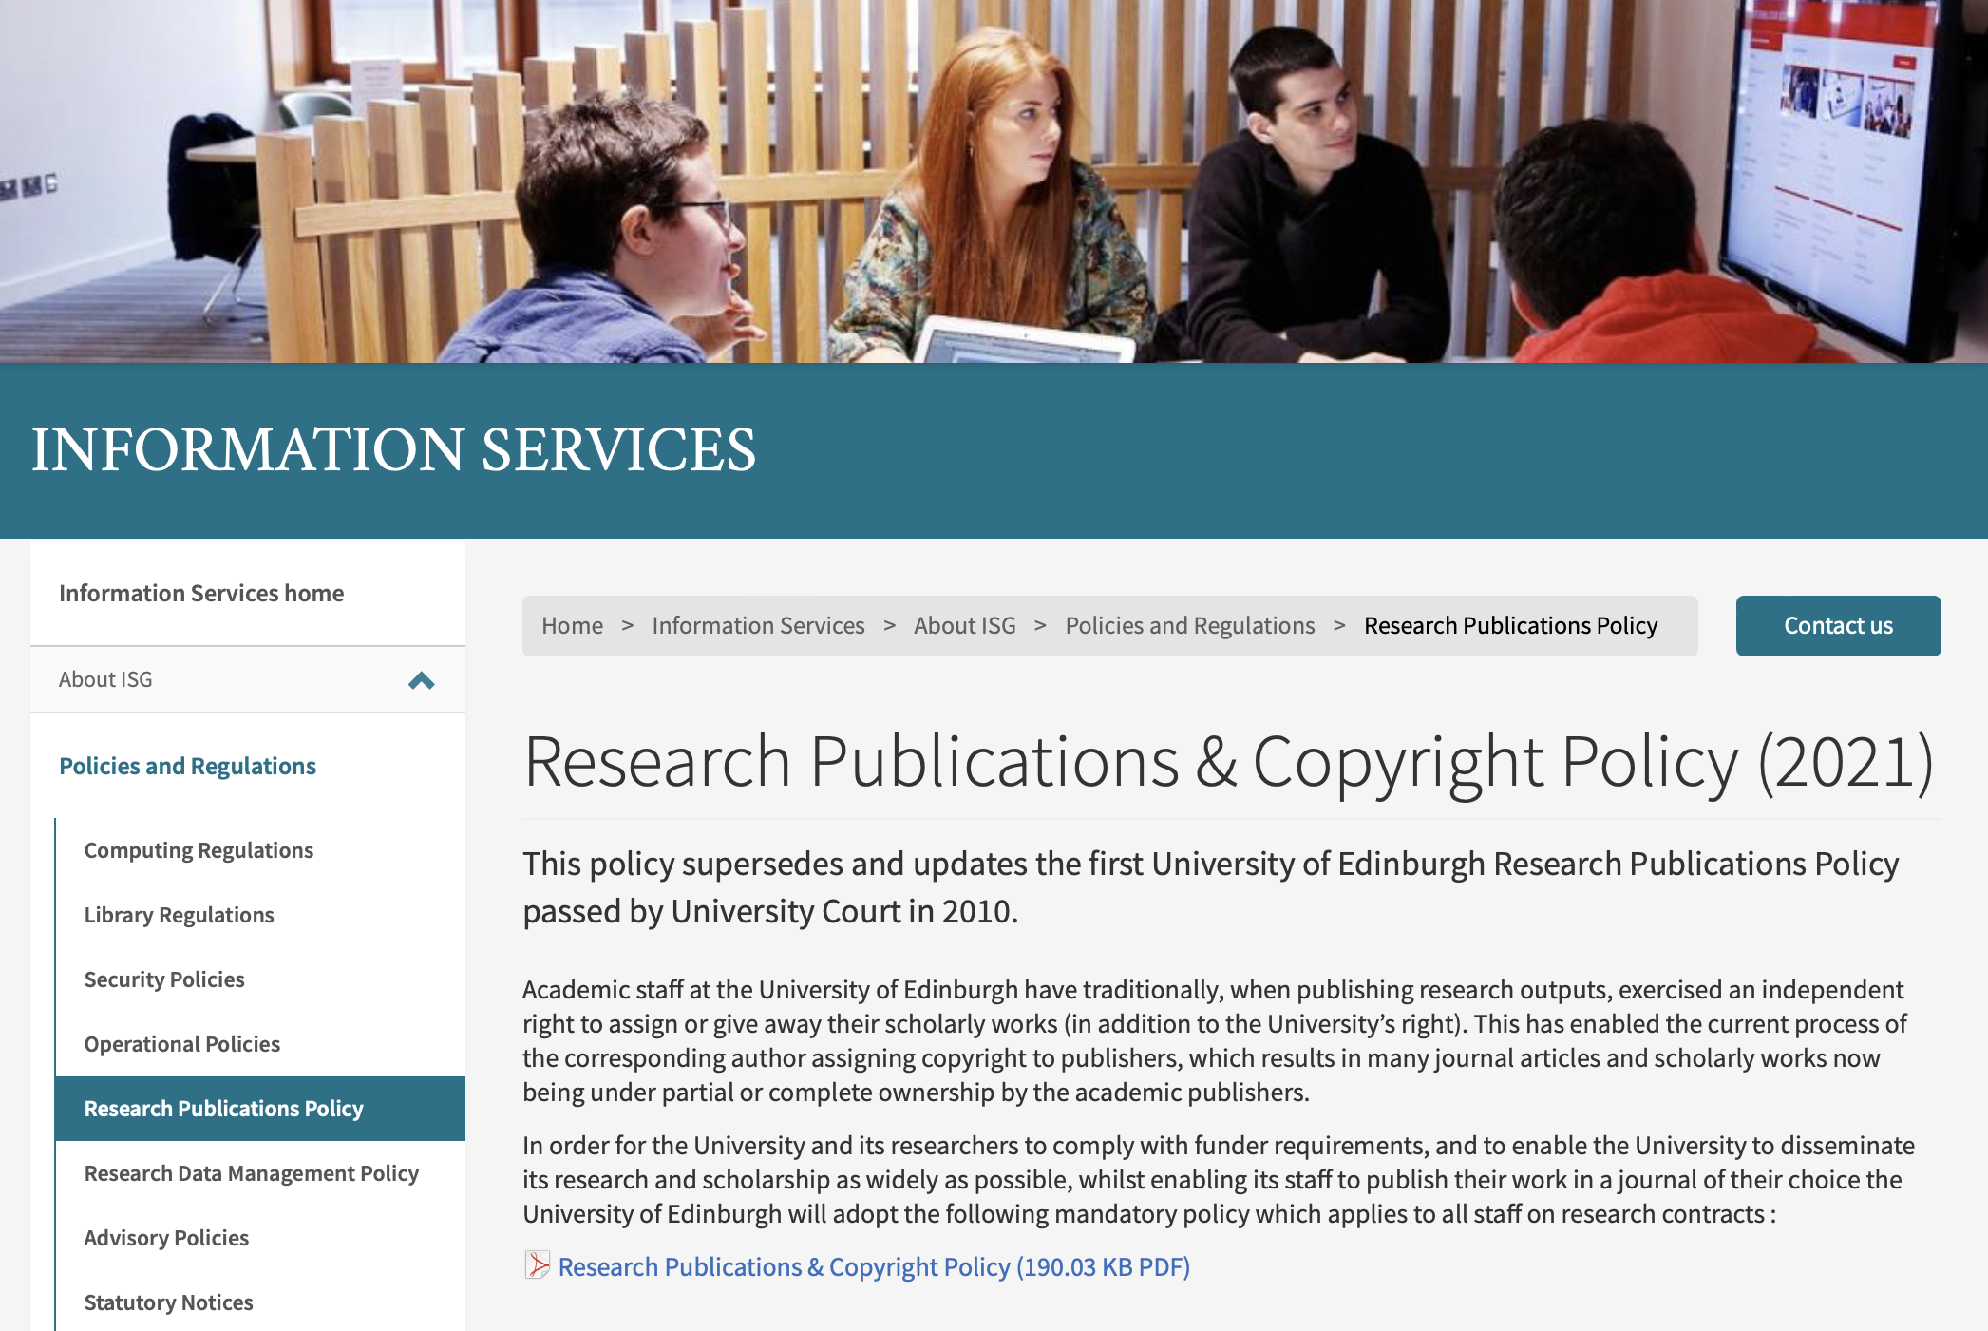
Rights Retention Strategy (RRS) Academe starts to take back control
https://www.ed.ac.uk/information-services/about/policies-and-regulations/research-publications
Notes:
A similar step has been taken at Edinburgh University
Members of the University have agreed to a rights retention policy to “allow University of Edinburgh researchers to make their journal articles and conference proceedings available on an open access basis as required by research funders under Plan S”

Slide 34
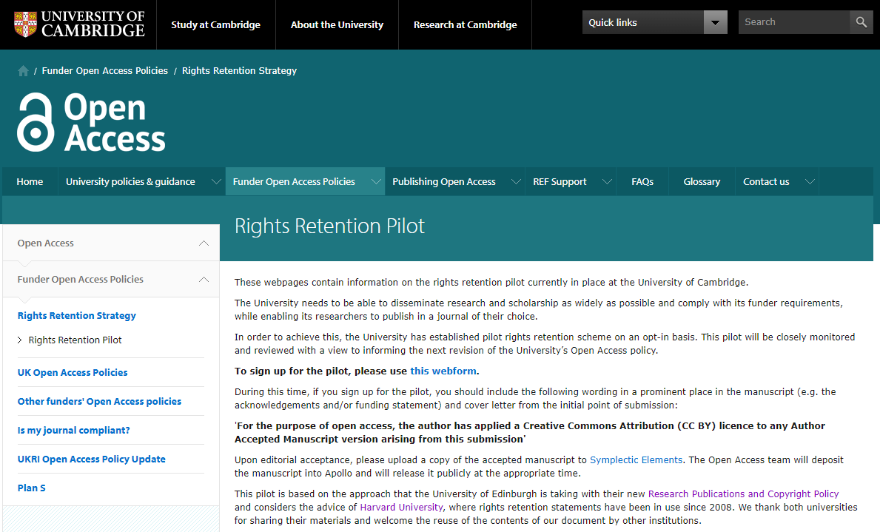
https://www.openaccess.cam.ac.uk/funder-open-access-policies/rights-retention/rights-retention-pilot
Notes:
The University of Cambridge has initiated a similar policy by running a rights retention pilot that will inform future policy.
This is a signal that researchers and their institutions are saying they’ve had enough of critical rights to valuable assets being freely given away to their disadvantage.

Slide 35
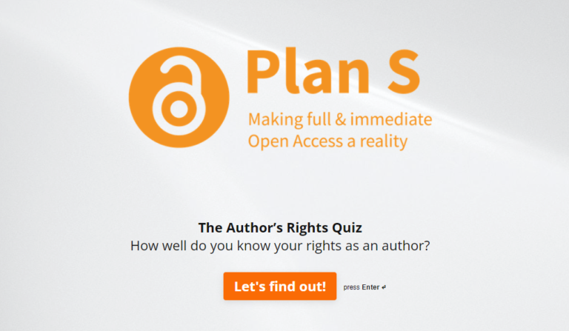
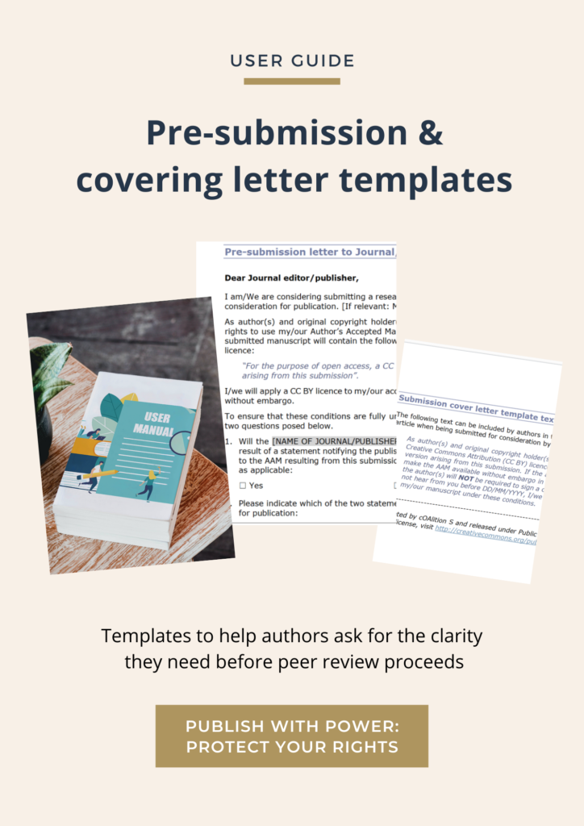
cOAlition S rights retention resources kit Available for all to use & adapt
Available at: https://www.coalition-s.org/resources/rights-retention-strategy/
Notes:
To assist researchers, institutions and their support staff, cOAlition S provides resources for anyone to use. You can find them on the website
A template of wording for authors to use to request clarity on the publisher’s position regarding article submission and author rights at the outset, rather than leaving the author (and all the reviewers) to go through the process of peer review before finding out the publisher demands their rights, and putting the author in a difficult situation
If the author doesn’t use that, there’s a second similar template to be used in the author’s covering letter asking for clarity from the publisher
A short video about rights retention
A quiz
This slide set – slides can be ‘cherry picked’ and adapted to suit your needs

Slide 36
Part 6 Summary

Slide 37
Summary
1. Article content belongs to the author for them to use as they choose for the benefit of authors, institutions, society in general
2. RRS helps authors retain their rights, whilst providing a tool to aid compliance with their funder agreement. An institutional RRS policy is even more powerful.
3. Whilst some publishers continue to deny authors their rights and grab them for themselves, key stakeholders can correct this state of affairs: funders: authors, institutions.

Slide 38
Further information
cOAlition S website - Rights Retention Strategy https://www.coalition-s.org/rights-retention-strategy/
Implementation roadmap for cOAlition S organisations https://www.coalition-s.org/plan-s-funders-implementation/
Journal Checker Tool: https://journalcheckertool.org/
Creative Commons licences: https://creativecommons.org/
email: info@coalition-s.org

Slide 39
Questions & Discussion
www.coalition-s.org
info@coalition-s.org
@cOAlitions_OA

